Slide 1

DIPLOMA IN FIRE & SAFETY ENGINEERING DIPLOMA IN INDUSTRIAL SAFETY (APPROVED BY BSS, GOVT. OF INDIA)
(An ISO 9001-2015 Certified Safety Training and Consulting Organization)

Slide 2
NATIONAL SAFETY DAY – 4th MARCH NATIONAL FIRE DAY- 14th APRIL

Slide 3

WHY SAFETY ???

Slide 4

WHY SAFETY???
MORAL
LEGAL
FINANCIAL

Slide 5

MORAL
Humanitarian reason, employer (owner or client) have the moral responsibility to provide
Safe Work Place
Safe Equipments / Tools
Safe Working Condition

Slide 6

LEGAL
As per the law,
Organization should full fill the legal requirement
To avoid fines and penalties

Slide 7

FINANCIAL
When an accident occurs, direct and indirect cost plays important role ……
DIRECT COST
INDIRECT COST

Slide 8
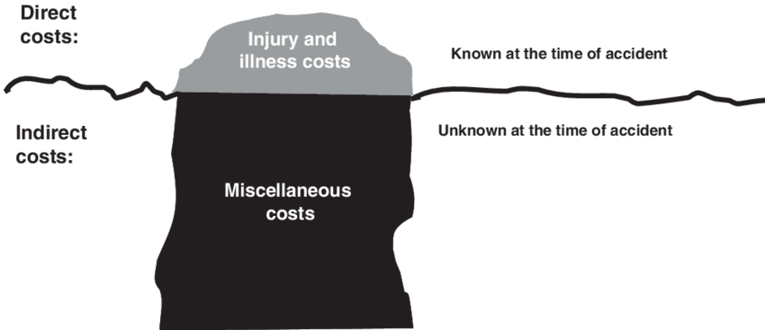
DIRECT COST
Costs directly accumulated from the accident
Measureable Cost
Directly From The Accident
Insured Cost
Examples
First Aid Cost
Medical Treatment Cost
Compensation Cost

Slide 9

INDIRECT COST
Cannot be measured which arises indirectly as the consequence of the event
Hidden Cost
Not Usually Insurable
Examples
Cost of overtime as a result of the accident
Cost of selecting, employing, training, educating new employees training for new workers

Slide 10
HSE
H - HEALTH
S - SAFETY
E - ENVIRONMENT

Slide 11

HEALTH
Health is a state of complete physical, mental and social well being
not merely the absence of diseases or infirmity

Slide 12

SAFETY
condition of being protected from injury

Slide 13

ENVIRONMENT
Environment means surroundings
Surrounding in which an organization operates
Avoid pollution of Air, Water, Land
Not to effect the natural resources, flora human and their inter relationship

Slide 14
DUTIES & RESPONSIBILITIES OF HSE OFFICER
1.Ensuring compliance with respect to health, safety, environmental as per the company, project HSE plan & statutory regulation
2. Ensuring & monitoring implementation of HSE policy & plan
3. Interacting & coordinating with client and other agencies
4. Monitoring safety procedure & their complaints
5. Ensuring and monitoring all working personal understand their HSE responsibilities

Slide 15
Conducting and organizing HSE training program
Conducting internal safety audit, safety meeting, mock drill, emergency evacuation drill
Organizing HSE promotional activities
Reporting and recording of accident investigation
Inspect the work place to identify hazard
Making report to the findings and recommend corrective action to the site management
Periodic inspection of fire and safety equipments

Slide 16
Preparing & updating company Safety Manual, HSE Plan, Job Safety Plan, Job Safety Analysis, Site Safety Rules, Emergency Plan
Ensure the availability and quality of PPE
Guiding and advising latest HSE norms and regulations to the management
Coordinate and maintain waste management systems
Discuss the safety issue with the management during weekly or monthly meeting

Slide 17


Slide 18
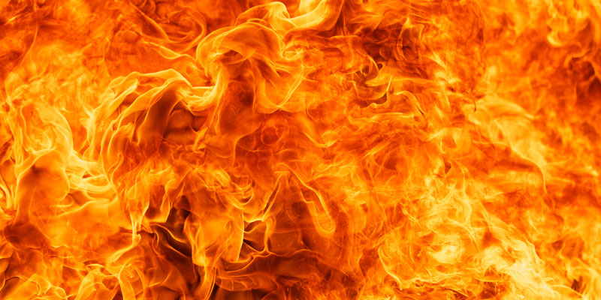
FIRE
Fire is a chemical chain reaction between Fuel, Heat and oxygen

Slide 19
CLASSIFICATION OF FIRE
 | DESCRIPTION | EXAMPLE
A (Solid) | Fire involving ordinary combustible solid materials | Wood, Paper, Textiles
B (Liquid) | Fire involving flammable liquids | Petroleum Products, Paints
C (Gases) | Fire involving gases or liquefied gases | LPG, H₂S, H₂
D (Metal) | Fire that occur in combustible metals | Sodium, Zinc, Potassium, Mg

Slide 20
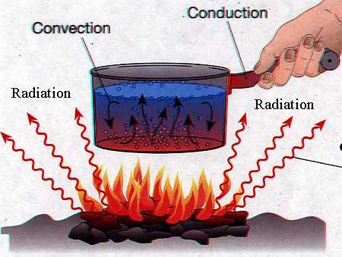
METHODS OF HEAT TRANSFER
CONDUCTION
Heat transfer through a medium of solid body
CONVECTION
Heat transfer through upward motion of heated matters
RADIATION
Heat transfer through air heat wave

Slide 21
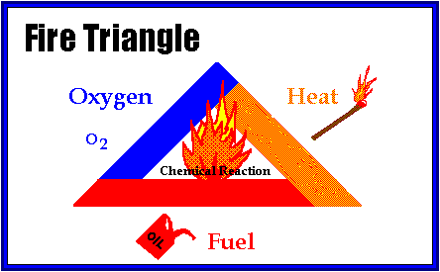
FIRE TRIANGLE

Slide 22
EXTINGUISHING METHODS
STARVATION
Limitation or removal of fuel from the scene of fire is known as starvation
SMOTHERING or BLANKETING
Limitation or removal of oxygen from the scene of fire is known as smothering
COOLING
Limitation or removal of heat from the scene of fire is known as cooling

Slide 23
EXTINGUISHING METHODS
STARVATION - REMOVAL OF FUEL
SMOTHERING - REMOVAL OF OXYGEN
COOLING - REMOVAL OF HEAT

Slide 24
EXTINGUISHING MEDIA
WATER
FOAM
DCP ( DRY CHEMICAL POWDER - NaHCO₃ , NH₄H₂PO₄)
CO2
SAND

Slide 25
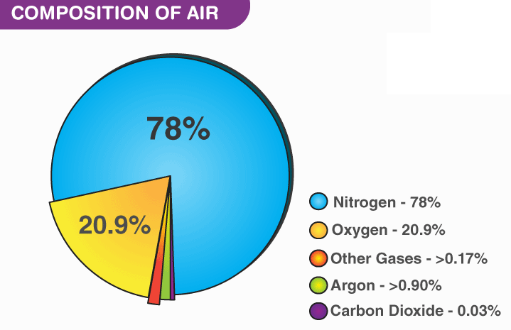

Slide 26
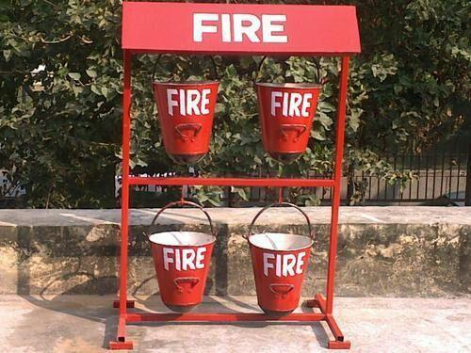
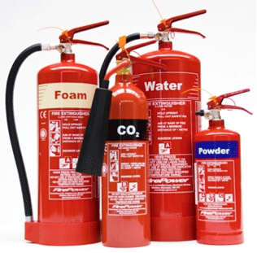

Slide 27
HOW TO USE FIRE EXTINGUISHER
It is easy to remember how to use a fire extinguisher, you can remember a shot form PASS which stands for
Pull
Aim
Squeeze
Sweep

Slide 28
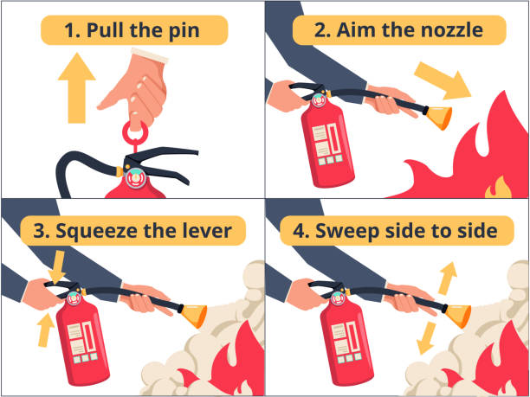

Slide 29
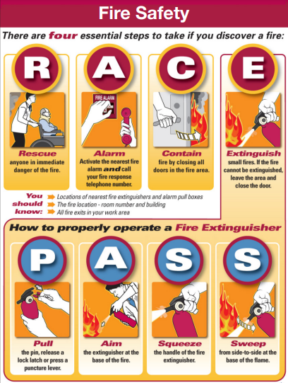

Slide 30
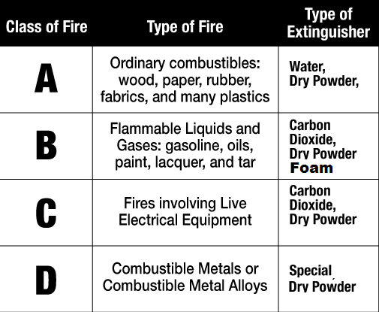
CLASSIFICATION OF FIRE EXTINGUISHER

Slide 31
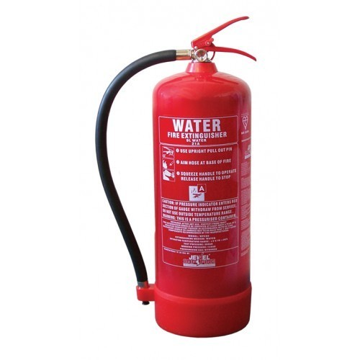
TYPES OF FIRE EXTINGUISHER
WATER

Slide 32
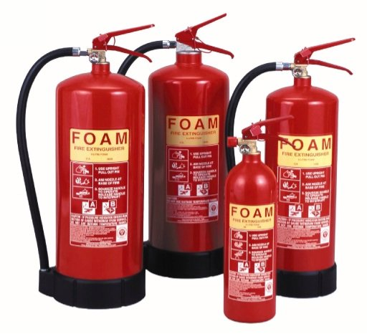
TYPES OF FIRE EXTINGUISHER
FOAM

Slide 33
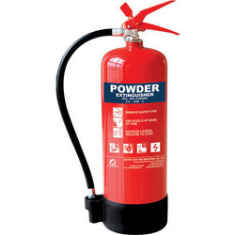
TYPES OF FIRE EXTINGUISHER
D - DRY
C - CHEMICAL
P - POWDER

Slide 34
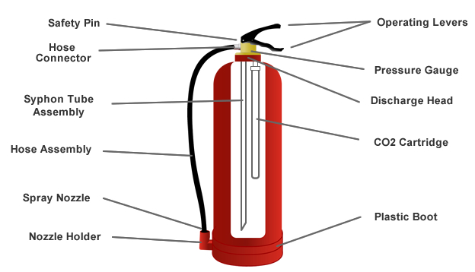
FIRE EXTINGUISHEN ANATOMY

Slide 35
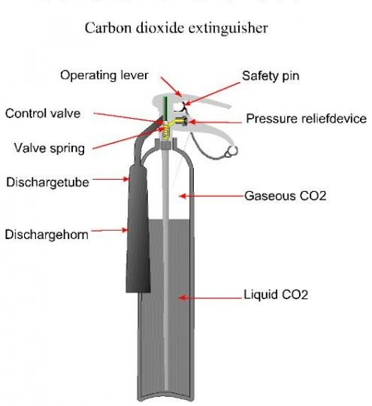
FIRE EXTINGUISHEN ANATOMY
CO2 TYPE

Slide 36

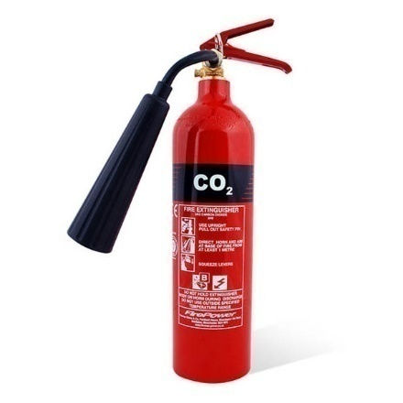
COLOUR OF EXTINGUISHER
WATER - RED
FOAM - CREAM
DCP POWDER - BLUE
CARBON DIOXIDE - BLACK

Slide 37
TYPES OF EXTINGUISHERS
STORED PRESSURE
Stored pressure fire extinguishers are easily the most common type
In these units, the expellant (propellant) is stored in the same cylinder as the agent itself
Different agents (Water, Foam, DCP Powder) used in the fire extinguisher may require different propellants (Nitrogen, Dry Air)
Dry Chemical Extinguishers typically use Nitrogen or Dry Air as propellant
Water and Foam Extinguishers typically use Dry Air as propellant

Slide 38
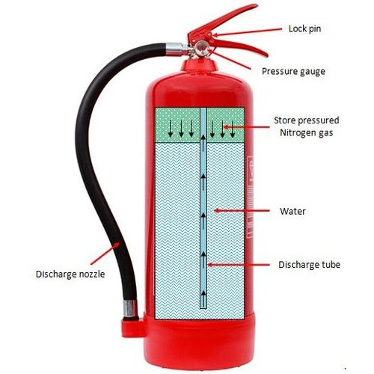

Slide 39
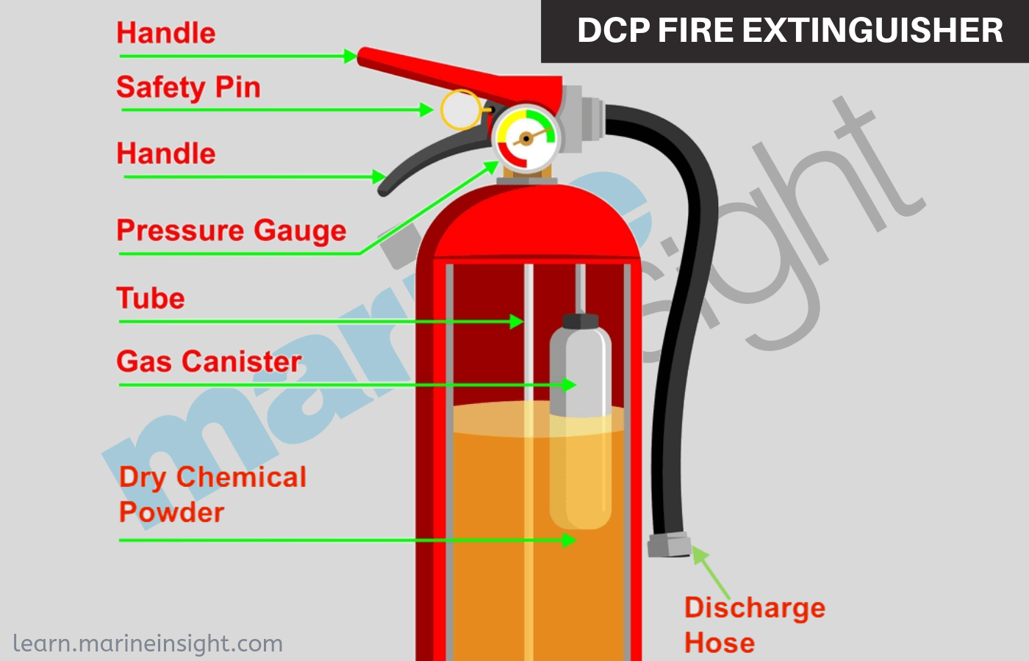
TYPES OF EXTINGUISHERS
CARTRIDGE TYPE
In cartridge operated units, the dry chemical is stored in the non-pressurized cylinder
while the propellant; either “Dry Air” or Nitrogen is stored in a separate cartridge located on the side of the unit

Slide 40
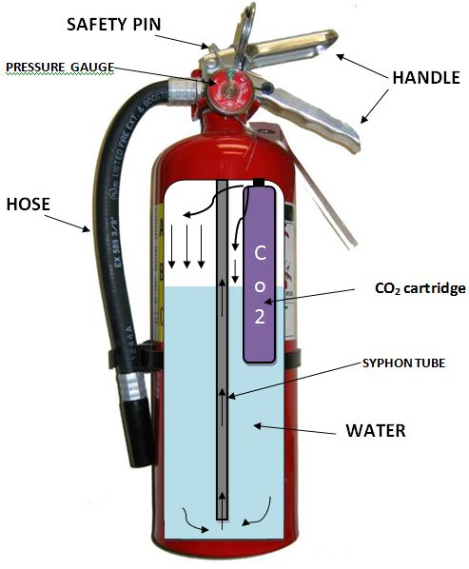
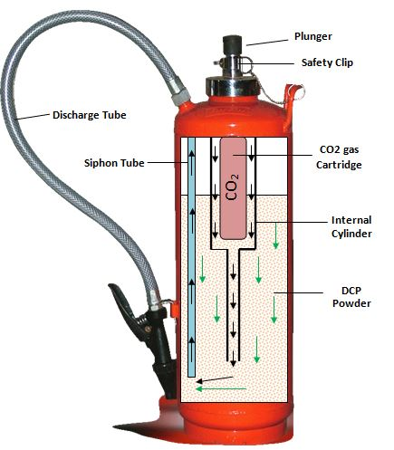

Slide 41
ADVANTAGES OF DCP
Harmless to skin
Non-conductor of electricity
Good for blast fire
Better than co₂ - on liquid fire
Non-toxic and non-corrosive

Slide 42
DISADVANTAGES OF DCP
DCP cannot be used on metal fire like Na, Mg
DCP cannot be used to produce inert atmosphere to prevent gas/vapour

Slide 43
FIRE EXTINGUISHER CHECKLIST
SI.NO | LOCATION | TYPE | PRESSER GUAGE | SAFETY PIN | DUE DATE | OUTER CYLINDER | HOSE NOZZLE | REMARK
1 | Workshop | ABC |  |  | 10/22 |  |  | Nil
2 | Office | CO2 |  |  | 10/22 |  |  | Nil

Slide 44
DEFINITIONS
ACCIDENTS
Accident is an unplanned event that cause personal injury, property damage, equipment damage or environmental pollution
INJURY
Injury is harmful condition / damage to body as a result of an accident
HAZARD
Hazard is a potential to cause harm to the body

Slide 45
DEFINITIONS
RISK
Risk is the combination of Likelihood (chance) of occurrence accident and Consequence (Severity) of the accident
R = L x C
NEARMISS
Near miss is an unplanned event which does not cause any personal injury, property damage, equipment damage or environmental pollution but it has potential to cause accident. (In feature)
TOOL BOX TALK
Tool box talk is a pre-job meeting in which supervisor / safety officer will explain about the job to be done and the hazard present in that job

Slide 46
DEFINITIONS
Who is a COMPETENT PERSON ?
One who is capable of identifying and predicting hazards in the work place
- Competent Person

Slide 47

STANDARED SAFETY SIGNAGE
MANDATORY- BLUE & WHITE

Slide 48

STANDARD SAFETY SIGNAGE
PROHIBITION – RED & BLACK

Slide 49
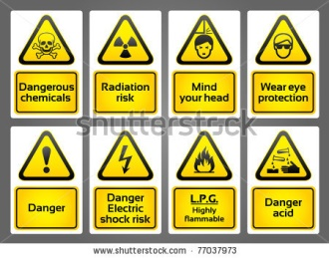
STANDARD SAFETY SIGNAGE
WARNING- YELLOW & BLACK

Slide 50
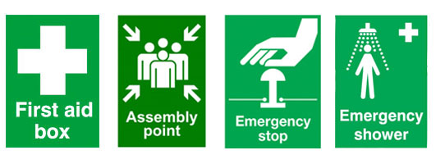

STANDARD SAFETY SIGNAGE
SAFE CONDITION- GREEN & WHITE

Slide 51

STANDARD SAFETY SIGNAGE
FIRE EQUIPMENT

Slide 52
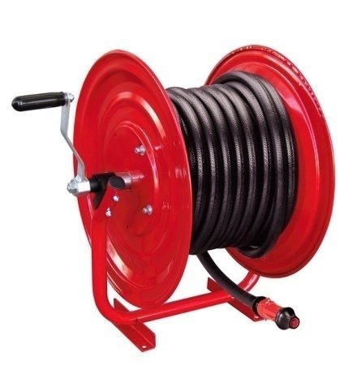
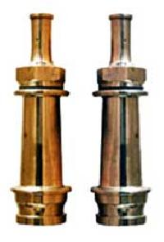
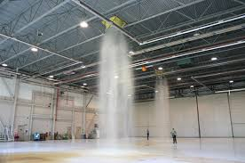
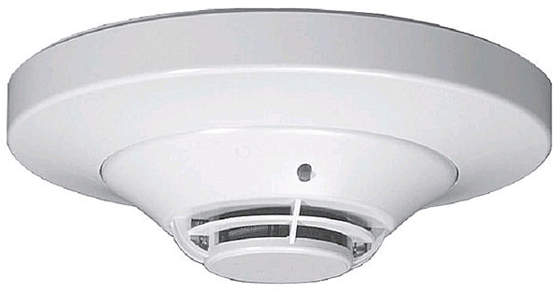
FIRE FIGHTING EQUIPMENTS
FIRE BLANKETS
HOSE REELS
FIRE FIGHTING HOSE
FIRE MONITOR
FIRE HYDRANT
SPRINKLER SYSTEM

Slide 53
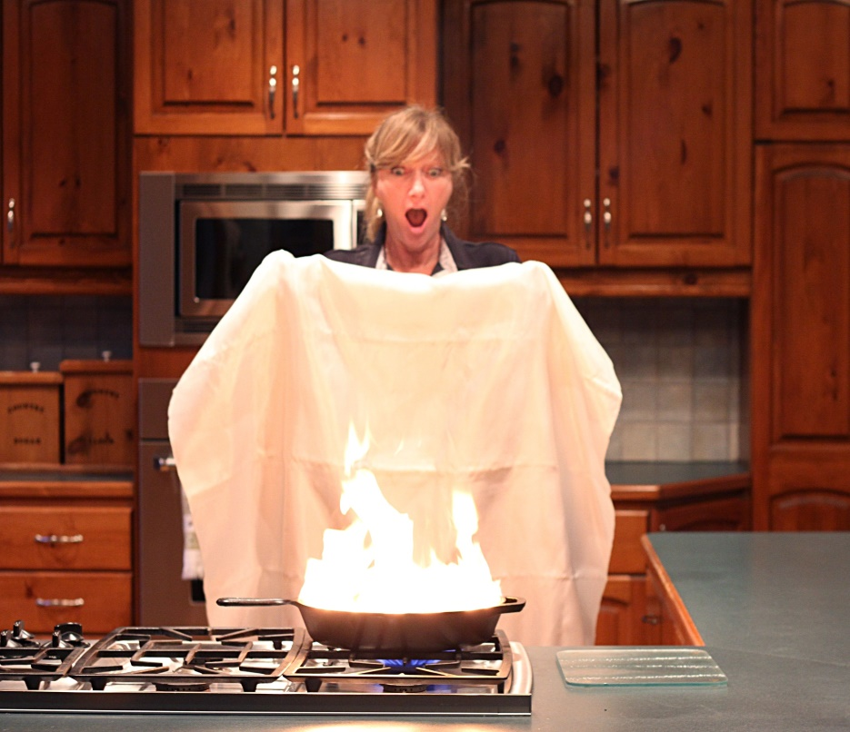
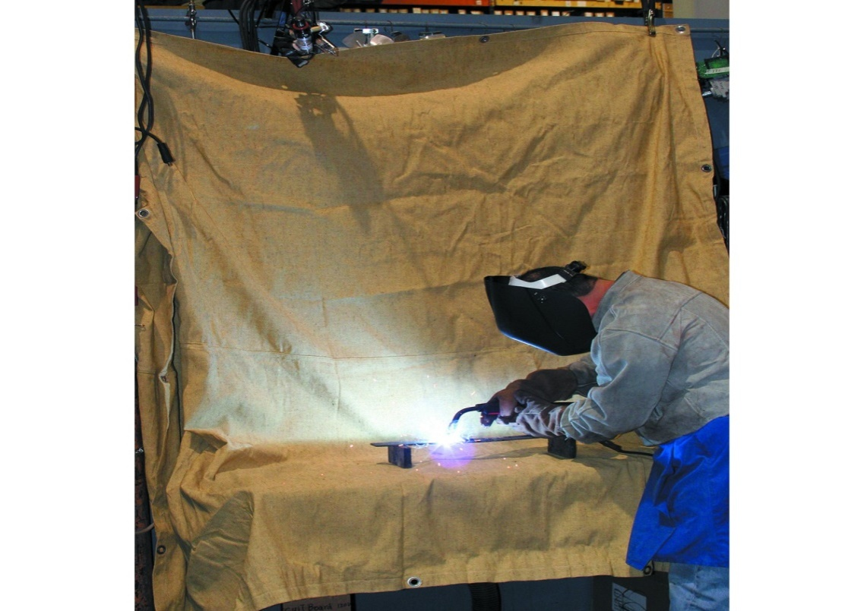
FIRE FIGHTING EQUIPMENTS
FIRE BLANKETS

Slide 54
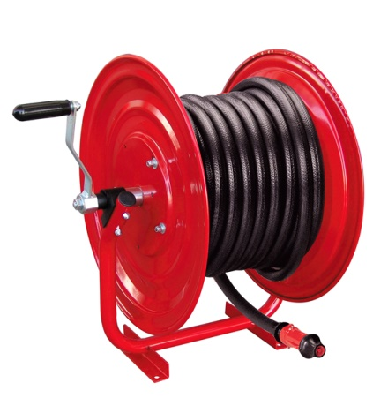
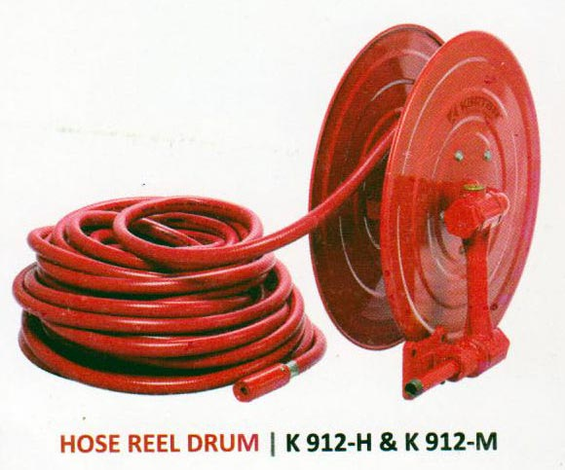
FIRE FIGHTING EQUIPMENTS
HOSE REELS

Slide 55
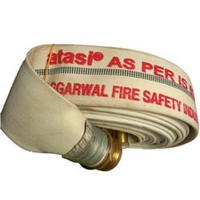
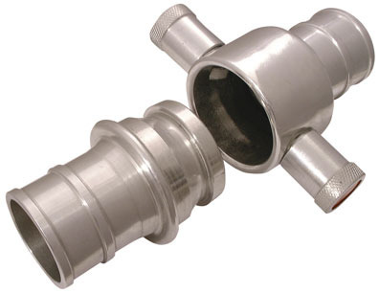
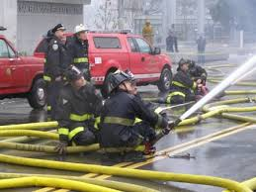
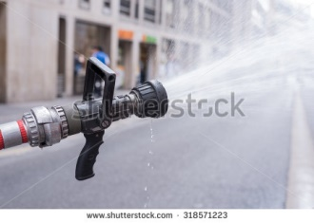
FIRE FIGHTING EQUIPMENTS
FIRE FIGHTING HOSE

Slide 56
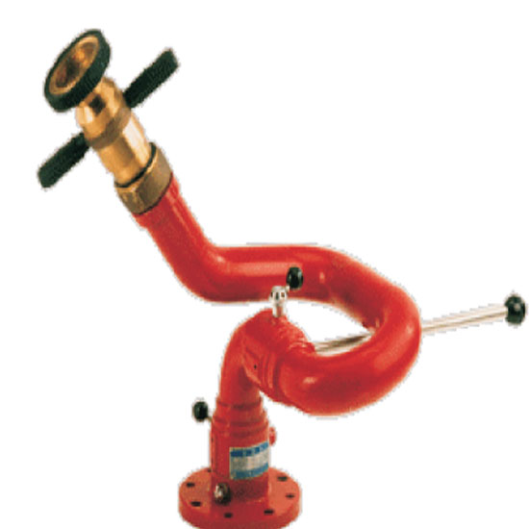
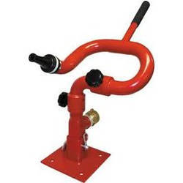
FIRE FIGHTING EQUIPMENTS
FIRE MONITOR

Slide 57
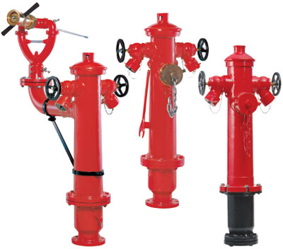
FIRE FIGHTING EQUIPMENTS
FIRE HYDRANT

Slide 58
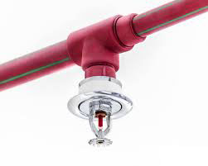
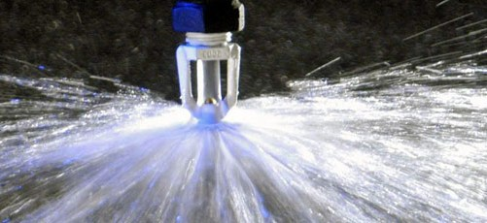
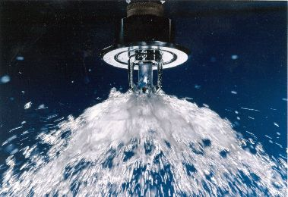
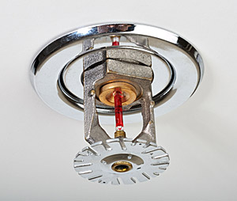
FIRE FIGHTING EQUIPMENTS
SPRINKLER SYSTEM

Slide 59
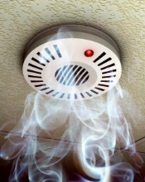
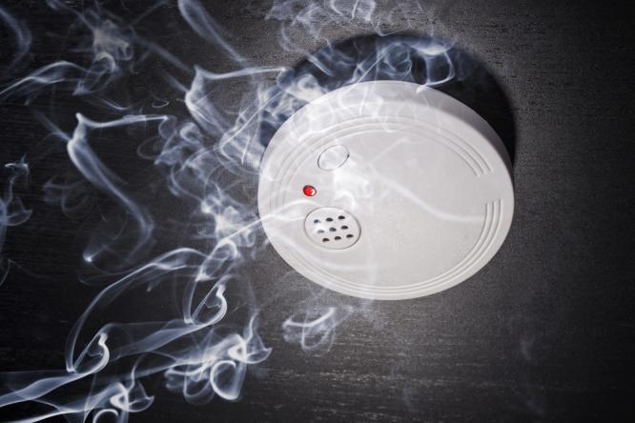
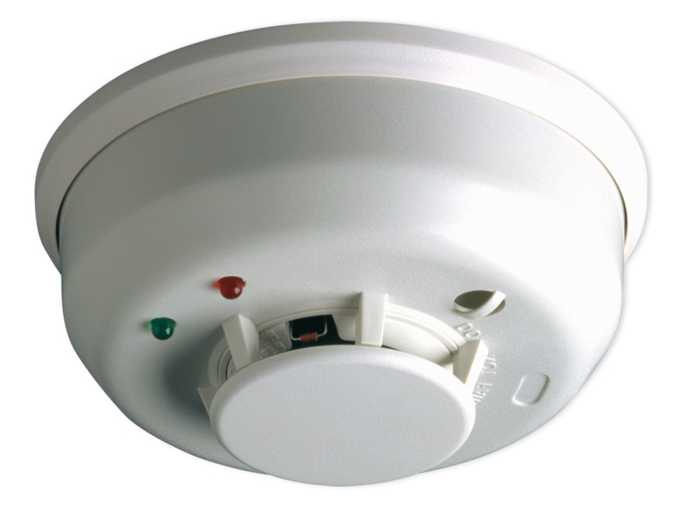
FIRE DETECTORS
SMOKE DETECTOR

Slide 60
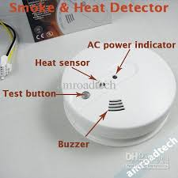
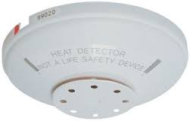
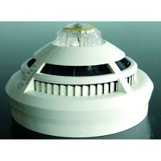
FIRE DETECTORS
HEAT DETECTORS – Temperature Sensor

Slide 61
COMMON CAUSES OF FIRE
Spark from electricity
Smoking
Hot Work
Naked Flame
Hot Surface
Spark from Vehicles
Static Electricity
Lightning

Slide 62
CONSEQUENCE OF FIRE
People get Injured & Killed
Damage to equipment/Building
Environment Damage

Slide 63
PERSONAL PROTECTIVE EQUIPMENT
(PPE)

Slide 64
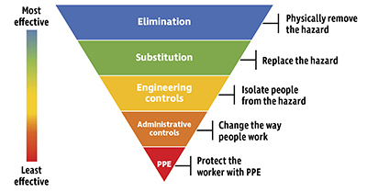
Hierarchy of Risk Control

Slide 65
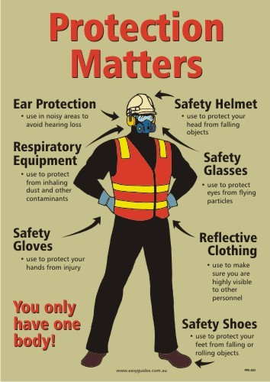
PPES

Slide 66
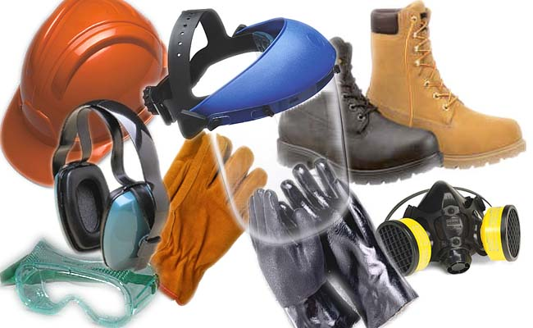
PERSONAL PROTECTIVE EQUIPMENT
PPE is equipment that will protect the user against health or safety risks at work

Slide 67








TYPES OF PPES
Respiratory Protective Equipment
e.g. SCBA, Air Respirators etc.
Non- Respiratory Protective Equipment
e.g. Hard Hat, Gloves, Goggles, Safety Shoes etc.

Slide 68
NON-RESPIRATORY PROTECTIVE EQUIPMENTS
COMMON PPE
Head Protection
Eye & Face Protection
Hand Protection
Foot Protection

Slide 69


HEAD PROTECTION
Prevention of head injures is an important factor in every job
Head Injuries are caused by falling, flying object or by jumbling the head against a fixed object

Slide 70


HEAD PROTECTION
HEAD INJURIES

Slide 71


EYE & FACE PROTECTION
To protect face from flying particle, splashing liquids, chemicals, chemical gas, vapours, potentially injurious light radiation suitable eye protector equipment to be given

Slide 72
TYPES OF EYE & FACE PROTECTION
Safety Glasses
Safety Goggles
Face Shields
Welding Goggles
Laser Safety Glass

Slide 73



EYE & FACE PROTECTION

Slide 74


FOOT PROTECTION
To protect feet and leg from falling objects, sharp objects, hot surface and wet surface suitable feet / leg protector equipment to be used
Safety shoes should be sturdy and acts as a protective covering to toe
Some shoes contain metal insole to protect feet from puncture wounds

Slide 75


FOOT PROTECTION

Slide 76


HAND PROTECTION
Hand protection equipment must be given to protect from hands from burns, abrasion, cuts, punctures, bruise, chemical exposure

Slide 77


HAND PROTECTION

Slide 78





TYPES OF GLOVES
Leather Gloves
Cotton Gloves
Chemical Protection Gloves
Insulated Rubber Gloves
Welding Gloves

Slide 79



EAR PROTECTION
Hearing protection device, also known as a HPD, is an ear protection device worn in or over the ears while exposed to hazardous noise (>85dB, 8hrs) to prevent noise-induced hearing loss
Ear Muff
Ear Plug

Slide 80


HEARING PROTECTORS
Ear Plugs - Preferred ( 20-30 dB )
Ear Muffs – 2nd Choice ( 15-30 dB )
Double Hearing Protectors ( plug & muff ) used for levels over 115 dB

Slide 81

NOISE LEVELS
Measured in decibels ( dB )
* Whisper - 10-20 dB
* Speech - 60 dB
* Noisy Office - 80 dB
* Passing Truck - 100 dB
* Jet Engine – 150 dB
Osha Limit – 85 dB

Slide 82
PERMISSIBLE EXPOSURE LIMIT – PEL
permissible noise exposure
Duration per day ( hours ) | Sound Level ( dB )
8 HOURS | 90 dB
4 HOURS | 95 dB
2 HOURS | 100 dB
1 HOURS | 105 dB
½ HOURS | 110 dB
¼ HOURS | 115 dB

Slide 83
RESPIRATORY PROTECTIVE EQUIPMENT
Respiratory protective equipment are life saving equipment

Slide 84
TYPES OF PROTECTIVE DEVICES
Air Purifying Devices (APD)
Air Supplying Devices (ASD)
Combination of air purifying and air supplying devices

Slide 85

AIR PURIFYING DEVICES
Air purifying device cleans the contaminated atmosphere
Various types of air purifying device
* Mechanical Filter Cartridge
* Chemical Cartridge
* Gas Mask
* Powered Air Purifying Devices

Slide 86

AIR PURIFYING DEVICES

Slide 87

AIR SUPPLYING DEVICES
Air supplying devices provide respirable atmosphere to the wearer, independent of the ambient air
Types of Air Supplying Devices
Self Contained Breathing Apparatus (SCBA)
Compressed Air Breathing Apparatus (CABA)
Emergency Escaping Breathing Apparatus (EEBA)
Air Line Respirator (ALR)

Slide 88

BREATHING APPARATUS ANATOMY

Slide 89
SAFETY INSPECTION
Definition
It is the process of identification of hazards
It helps to give control measure
During a Site Safety Inspection
House Keeping
Safety Sign Board
Welfare Facility
Fencing & Security
Stores & Storage System
Fire Extinguisher

Slide 90
Fire Procedures
First Aid Facility
PPE (Personal Protective Equipment)
Barricading
Scaffolding & Working Platform
Ladder
Cranes & Lifting Equipment
Excavation
Confined Space
Electricity
Over Head & Under Ground Services
Electrical Equipment & Tools
Welding Equipment
Hazardous Substances To Health
Other Hazards

Slide 91

HOUSE KEEPING
GLOBAL SAFETY STUDIES

Slide 92
HOUSE KEEPING
Definition
Place for everything and everything in its proper place
Good House Keeping is the key to Safety
House Keeping
is
Everyone’s Responsibility

Slide 93

HOUSE KEEPING
Benefits of House Keeping
Good house keeping prevents accidents and injuries
Good house keeping save space, time and materials
When a work place is clean workers feel better, think better, and do better
Good impression with visitors
Hazard elimination

Slide 94


HOUSE KEEPING
Accidents due to poor house keeping
Tripping over loose objects on floors, stairs and platforms
Falling objects cause hit injury
Slipping on greasy, wet or dirty surface

Slide 95



HOUSE KEEPING
INJURIES FROM SLIP FALL &TRIP FALL
Broken bones
Back or spine injury
Sprains
Death

Slide 96
HOUSE KEEPING
GOOD HOUSE KEEPING
All material should be properly stored
Keep bolts, nuts, etc… in a tray/ bucket
Pipes, scaffold materials, etc… are potential trip hazard. Don’t store in the walkway
Don’t store materials on working platform and near access Ladder / Stair
Don’t route cables & hoses through staircase / ladder posing potential trip hazard
Don’t drain sticky material/oil on floor posing slip fall hazard

Slide 97

HOUSE KEEPING
Don’t use fire water for cleaning
Don’t block access to fire and emergency equipment

Slide 98
HOUSE KEEPING
Good House Keeping Checklist
Walls cleans
Window cleans
Provide proper lighting system
Platform in good condition
Stairs clean and dry
Free from oil, grease etc…
Safe and free access to work position
Employees Facilities
Waste Disposal
Storage
Tools and Equipment

Slide 99

HOUSE KEEPING
WHAT IS YOUR FAVORITE PLACE TO WORK ?

Slide 100


HOUSE KEEPING
BAD HOUSEKEEPING
Example: Waste container over flowing

Slide 101
HOUSE KEEPING
GOOD HOUSE KEEPING

Slide 102





HOUSE KEEPING
BAD HOUSE KEEPING

Slide 103

ENVIRONMENT
GLOBAL SAFETU STUDIES

Slide 104

ENVIRONMENT
DEFINITION
Environment means the surrounding in which as organization operate including Air, Water, Land, natural resources, flora human and their inter relationship.

Slide 105



ENVIRONMENT
TYPES OF POLLUTION
AIR POLLUTION
WATER POLLUTION
LAND POLLUTION

Slide 106



ENVIRONMENT
Effects of pollution
Reduced lung functioning
Irritation of Eyes, Nose, and Mouth
Asthma attack
Respiratory disease
Reduce energy level
Head ache
Mental disorder
Cancer
Death

Slide 107
ENVIRONMENT
How to save environment
Do not waste water
Prevent pollution on the ground, air, and water by avoiding any chemical spills
Ensure all waste is collected and placed in to the specific containers
Use toilet facilities
Do not burn waste
Do not kill any wild
Report any chemical spills
Site vehicle to have spill kits
Store chemical only in the approved storage area where spill kit are available

Slide 108
WASTE MANAGEMENT
WHAT IS WASTE MANAGEMENT ???..
Waste management - safely disposing the by-product of a process or a work to the environment ( after proper treatment, if necessary)
So that no threat for livings, properties and environment exists

Slide 109





WASTE DISPOSAL
CLASSIFICATION OF WASTE
HAZARDOUS WASTE
NON-HAZARDOUS WASTE

Slide 110





WASTE DISPOSAL
HAZARDOUS WASTE
Highly flammable waste
Chemical waste
Toxic waste
Corrosive waste
Electronic waste

Slide 111



WASTE DISPOSAL
NON- HAZARDOUS WASTE
House waste
Food waste
Paper
Wood
Cotton

Slide 112



WASTE DISPOSAL
SEGREGATION (பிரித்து வைத்தல்)
Waste must be segregated to prevent the mixing and contamination of one type of waste with another.
It usually requires separate as well as secure storage for each type waste with clear identification

Slide 113
Movement
People Movement
Vehicle Movement

Slide 114
MOVEMENT
OF
PEOPLE

Slide 115



MOVEMENTS OF PEOPLE
Hazard: Slip Fall & Trip Fall
Cause of Slip Hazard
Smooth floor surface
Wet
Oil and Grease
Frost and Ice

Slide 116



MOVEMENTS OF PEOPLE
Cause of Trip Hazard
Uneven or loose floor surface
Trailing cables
Object at floor

Slide 117




MOVEMENTS OF PEOPLE
Control Measures
Good House Keeping
Risk Assessment
Maintenance of Machinery
Slip Resistance Surface
Spillage Control kit
Use of proper signage and PPE
Lay cables / Cable Rails
Designated Walk Ways

Slide 118
MOVEMENT
OF
VEHICLE

Slide 119

VEHICLE COLLISION
GLOBAL SAFETY STUDIES

Slide 120



VEHICLE COLLISION
Collision can occur between the vehicle
Other Vehicle
Pedestrians
Fixed object

Slide 121
VEHICLE COLLISION
Factors that increase the Risk of Vehicle Collision
Driver Error
Example: Driving Too Fast
Inadequate Lighting
Reversing with out the help of a banks man
Bad Weather Condition
Obstructed Visibility
Poor design of Pedestrian Walkways and Crossing point
Lack of Vehicle Maintenance
Example: Break Failure

Slide 122


MAIN CAUSES OF ACCIDENT
ACCIDENT
Accident is an unplanned event that results Personal Injury or Property Damage or Equipment Damage or Environmental Pollution.
Unsafe Action
Unsafe Condition

Slide 123
UNSAFE ACTION
Definition
Where the action of the people in the work place directly cause or contribute to the incident
Use wrong tools
Arranging or placing object unsafely
Using equipments unsafely
Operating without permission

Slide 124
UNSAFE ACTION
Working At Unsafe Speed
Using Defective Equipment & Tools
Failure to use of PPE
Improper Lighting
Smoking
Horse Play
Not Using Safety Devices
Not Reporting Safety Problems
Working under the Influence of Alcohol

Slide 125





UNSAFE ACTION

Slide 126
UNSAFE CONDITION
DEFINITION
WHERE THE PHYSICAL CONDITION AT THE WORK PLACE, OR METHODS OF WORK, DIRECTLY CAUSE OR CONTRIBUTE TO THE INCIDENT
INADEQUATE GUARDING
DEFECTIVE TOOLS
INADEQUATE VENTILATION
EXCESSIVE NOISE

Slide 127
UNSAFE CONDITION
NO PERSONAL PROTECTIVE EQUIPMENTS
WET AND SLIPPERY SURFACE
BAD HOUSEKEEPING
UNSAFE LIFTING
UNSAFE EQUIPMENTS
UNSAFE SYSTEM OF WORK
UNSAFE ENVIRONMENTAL CONDITIONS

Slide 128





UNSAFE CONDITION

Slide 129



DOMINO THEORY
88% of accidents due to unsafe action
10% of accidents due to unsafe condition
2% Unavoidable Accidents

Slide 130

ELECTRICAL SAFETY
GLOBAL SAFETY STUDIES

Slide 131

ELECTRICAL SAFETY
ELECTRICITY
Flow of electron in a conductor in a closed circuit
Flow of current only possible by voltage source

Slide 132
ELECTRICAL SAFETY
ELECTRICAL HAZARD
PRIMARY HAZARD
SECONDARY HAZARD

Slide 133



PRIMARY HAZARD (B-SAFE)
BURN
SHOCK
ARC FLASH
FIRE
EXPLOSION

Slide 134
SECONDARY HAZARD
Person fall from height
Lose of information
Dropping of tool and objects
Unexpected movements of machinery
Health hazard due to release of Toxic Gas & Production of UV rays
Environmental Hazard

Slide 135
ELECTRICAL SAFETY
Effects of Electrical Shock
Damage to nervous system
Irregular heart beat
Internal burns
Stop breathing
Skin surface burn

Slide 136
ELECTRICAL SAFETY
Major Cause of Electrical fire
Overloading of circuit
Octopus wiring
Improperly rate circuit
Poor damage insulation
Poor connection
Flammable materials

Slide 137
ELECTRICAL SAFETY
ELECTRICITY PROTECTIVE DEVICES
FUSE
EARTHING
ISOLATION
ELCB
MCB
RCD

Slide 138


SAFETY ARRANGEMENTS
Proper Inspection
Use Distribution Board (DB)
All cable joints made with Industrial Plug
Give proper Earthling (Double Earthling)
Use proper PPE
Generator area to be cleaned properly
No flammable material near DG
Provide Extinguisher, Sign Board and Barricading around the DG
Don’t lay cables on wet area

Slide 139




ELECTRICAL SAFETY
INDUSTRIAL PLUG.

Slide 140
ELECTRICAL SAFETY
Emergency Action
Don’t touch the casualty
Call for help
Isolate from the power supply
Call for ambulance
Check for breathing
Treat burns
Treat for physical shock
Ensure medical assistance

Slide 141

LOTO (LOCK OUT TAG OUT)

Slide 142

LOTO
Definition
Lockout means physically neutralize all energies in a piece of equipment before beginning any maintenance or repair work.
Lock out generally involve , Stopping all energy flows and provide a tag to help
Isolation Types : Mechanical and Electrical

Slide 143

LOTO- COLOUR CODE
ELECTRICAL DEPT - RED
MECHANICAL DEPT - YELLOW
INSTRUMENTATION DEPT - BLUE

Slide 144








LOTO
DIFFERENT TYPES OF LOCKS

Slide 145


ISOLATION
Electrical isolation is the separation between two circuits that restricts the Direct Current (DC) and any unwanted Alternating Current (AC) in a power supply.
Isolation prevents dangerous voltages to the operator in the event of an electrical fault/failure or during a surge from lightning.

Slide 146

SCAFFOLDNG

Slide 147
SCAFFOLDNG
DEFINITION
Scaffolding is a temporary elevated platform to do the height work safely
INTRODUCTION
It is estimated that 2.3 million construction workers deal with scaffolding each year. More than 10,000 workers are injured and 80 are killed in scaffolding related accidents

Slide 148
TYPES OF SCAFFOLDS
Frame Scaffolding
Tube and Clamp Scaffolding
Modular System Scaffolding
Rolling Scaffolding (Mobile Scaffolding)
Suspended Scaffolding

Slide 149


TYPES OF SCAFFOLDS
FRAME SCAFFOLDING

Slide 150


TYPES OF SCAFFOLDS
TUBE AND CLAMP

Slide 151



TYPES OF SCAFFOLDS
MODULAR SYSTEM SCAFFOLDS

Slide 152


TYPES OF SCAFFOLDS
ROLLING SCAFFOLDING (MOBILE SCAFFOLDING)

Slide 153


TYPES OF SCAFFOLDS
SUSPENDED SCAFFOLDIND

Slide 154
TYPES OF SCAFFOLDING ( BASED ON WORKING LOAD)
LIGHT DUTY SCAFFOLD
MEDIUM DUTY SCAFFOLD
HEAVY DUTY SCAFFOLD
SPECIAL DUTY SCAFFOLD

Slide 155

LIGHT DUTY SCAFFOLD
Scaffold designed and constructed to carry a working load not exceed 150kg/m²

Slide 156

MEDIUM DUTY SCAFFOLD
Scaffold designed and constructed to carry a working load not exceed 200kg/m²

Slide 157

HEAVY DUTY SCAFFOLD
Scaffold designed and constructed to carry a working load not exceed 250kg/m²

Slide 158

SPECIAL DUTY SCAFFOLD
SCAFFOLD DESIGNED AND CONSTRUCTED TO CARRY SPECIFIC TYPE OF OBJECTS

Slide 159




COMMON PARTS OF SCAFFOLD
Sole board/ sills
Base plate
Standard/ post
Ledger
Brace
Transom
Coupler
Working platform
Guard rails
Access ladder

Slide 160


COMMON PARTS OF SCAFFOLD
SOLE BOARD/SILLS
SILVER OAK WOODEN PLANK SUPPORRT BASE PLATE AT GROUND.

Slide 161

COMMON PARTS OF SCAFFOLD
BASE PLATE
IT IS A MILD STEEL SQUARE-PLATE

Slide 162

COMMON PARTS OF SCAFFOLD
STANDARD/POST
IT IS VERTICAL SCAFFOLD TUBE

Slide 163

COMMON PARTS OF SCAFFOLD
LEDGER
IT IS HORIZONTAL SCAFFOLD TUBE

Slide 164


COMMON PARTS OF SCAFFOLD
BRACE
A TUBE PLACED TO THE VERTICAL AND HORIZONTAL MEMBERS OF A SCAFFOLD AND FIXED TO THEM TO GIVE STABILITY.

Slide 165


COMMON PARTS OF SCAFFOLD
TRANSOM
TUBES FIXED AT RIGHT ANGLE ACROSS THE LEDGERS, ADJACENT TO EATCH PAIR OF STANDAEDS TO SUPPORT THE SCAFFOLD BOARDS

Slide 166

COMMON PARTS OF SCAFFOLD
COUPLER
A DEVICE FOR LOCKING TOGETHER COMPONENT PARTS OF TUBE AND COUPLER SCAFFOLD .

Slide 167







COUPLER
TYPES OF COUPLERS

Slide 168


COMMON PARTS OF SCAFFOLD
WORKING PLATFORM
AN ELEVATED WORK SURFACE COMPOSED OF ONE OR MORE PLATFORM UNITS.

Slide 169


COMMON PARTS OF SCAFFOLD
GUARD RAILS
TOP RAIL
MID RAIL
TOE BOARD

Slide 170
COMMON PARTS OF SCAFFOLD
GUARD RAILS- HEIGHT
TOP RAIL
MID RAIL
TOE BOARD
 | 70 CM |  | TOTAL- 110 CM
 | 40 CM
 | 15 CM

Slide 171


LADDER
Hazards of Ladders
Don’t stand ladder on drum, box or other unstable base
Never attempt to repair broken ladder
Never carry load up ladder hoist it up
When using the metal ladder, , make sure there are no electrical hazard in the near vicinity
Falling off the ladder

Slide 172


LADDER
SAFE LADDER PLACING
Ladder should be set an angle of about 75 or one meter for every four meter rise

Slide 173

LADDER
LADDER-SAFETY
Use only approved ladders
Inspect before use
One person only
Use fall arrest if > 6 ft (1.8m) working from ladder
Extend 3 feet above access or working level
use 4:1 lean ratio
Use 3 point contact

Slide 174

LADDER
LADDER SAFETY

Slide 175


LADDER
MONKEY LADDER

Slide 176
HAZARDS - SCAFFOLDING
Fall from scaffold during erection
Fall from working platform
Electrocution- from overhead power lines
Falling object
Scaffold collapse

Slide 177
CAUSE OF SCAFFOLD COLLAPSE
Over loaded working platform
Soft ground
Not tied properly with the building
Brazing insufficient
High wind
Incorrect copular
Scaffold erected by incompetent workers
Scaffold not inspected prior to use

Slide 178
SAFETY ARRANGEMENTS -SCAFFOLD
Use appropriate scaffold construction method
Proper inspection
Trained and certified worker
Not exceed (SWL) Safe Working Load
Erection on a level ground
10 feet safe distance from power line
Proper fall protection system

Slide 179
SCAFFOLD FALL PROTECTION SYSTEM
Guard Rail
Top Rail
Mid Rail
Toe Board
Training
Barricading
Full Body Harness
Safety Nets
Safety Monitoring
PFAS – Personal Fall Arrest System

Slide 180


SCAFFOLD FALL PROTECTION SYSTEM
FULL BODY HARNESS

Slide 181

FULL BODY HARNESS
PARTS OF HARNESS

Slide 182



SCAFFOLD FALL PROTECTION SYSTEM
SAFETY NETS

Slide 183
SCAFFOLD FALL PROTECTION SYSTEM
GUARD RAILS
TOP RAIL
MID RAIL
TOE BOARD

Slide 184
SCAFFOLD INSPECTION CHECK LIST
Check For Missing Planks On Platform
Check For Missing Guard Rail System
Check For Proper Access
Check For House Keeping On Scaffold Platform (Loose Materials, Working Waste Etc…)
Check For Proper Tying Off Building

Slide 185



SCAFF TAG SYSTEM
THREE TYPES OF SCAFF TAG
RED TAG – Don’t use
GREEN TAG – OK to use
YELLOW TAG – Check with Supervisor
If there is
NO TAG -
DON’T USE

Slide 186

WORK AT HEIGHT
GLOBAL SAFETY STUDIES

Slide 187
WORK AT HEIGHT
DEFINITION
Work there is a risk of fall liable to cause injury
Any work above 1.8 meter from ground level is called work at height

Slide 188




WORK AT HEIGHT
RESULT OF FALLING FROM HEIGHT
FATALITY
SPINAL INJURY
MULTIPLE BROKEN BONES

Slide 189

WORK AT HEIGHT
HAZARDS OF WORK AT HEIGHT
VERTICAL HEIGHT
FALLING METERIALS
WEATHER
UN PROTECTED EDGS
SLOPPING ROOFS

Slide 190

WORK AT HEIGHT
CONTROL MEASURE FOR WORKING AT HEIGHT
TRAINING
BARRICATION
FULL BODY HARNESS
SAFETY NETS
PFAS-PERSONAL FALL ARREST SYSTEM
GUARD RAILS

Slide 191

MANUAL HANDLING
GLOBAL SAFETY STUDIES

Slide 192

MANUAL HANDLING
DEFINITION
Task which involves people moving or handling or shifting of materials by using bodily force
Example:
Lifting
Lowering

Slide 193



MANUAL HANDLING
Manual Handling Hazards
Twisting and Turning
Heavy Load
Dropping Load
Sharp Edges
Hot Load

Slide 194




MANUAL HANDLING
Manul handling injuries
Back injuries
Muscular sprain
Cuts and abrasion
Fracture
Open injuries
Swelling
Hernia

Slide 195

MANUAL HANDLING TECHNIQUE
Assess the load
Position of feet
Bend knees
Leg muscle support
Back straight
Arm closed to the body
Avoid twisting

Slide 196

EXCAVATION
GLOBAL SAFETY STUDIES

Slide 197

EXCAVATION
Definition
Digging of earth surface or making depression on earth surface
Either manually or mechanically
What is Trench ?
Trench is a narrow excavation depth is greater than width

Slide 198




EXCAVATION
Excavation hazard
Cave in
water accumulation
Oxygen deficiency
Toxic and flammable gases
Falling objects
People falling
Side wall collapse

Slide 199
EXCAVATION
Preventive Measures
Proper inspection
Provide sign board
Barricading
Suitable side wall protection system (Sloping & Benching, Shoring, Shielding)
De-watering system
Proper PPE
Conduct gas test (O2, CO, H2S, Methane)
Removed soil , two feet from the side
Around traffic, use reflective vets
Access ladder

Slide 200




EXCAVATION
EXCAVATION- SUITABLE SIDE WALL PROCTION SYSTEM
SLOPING
BENCHING SYSTEM
SHORING SYSTEM
SHIELDING SYSTEM

Slide 201


EXCAVATION PROTECTION SYSTEM
sloping
A method of excavating in which the sides of an excavation are laid back to a safe angle to prevent cave-in

Slide 202

EXCAVATION PROTECTION SYSTEM
BENCHING
A method of protecting employees from cave-ins by excavating the side s of an excavation to form one or a series of horizontal steps

Slide 203

EXCAVATION PROTECTION SYSTEM
SHORING
Hydraulic, timber or mechanical system that support the sides of an excavation , designed to prevent cave-ins

Slide 204

EXCAVATION PROTECTION SYSTEM
SHIELDING
A structure that is able to with stand the forces imposed on it by cave-ins, and in the process, protects employees inside the structure

Slide 205
SITE CONDITION SHALL BE CHEKED BEFORE STARTING EXCAVATION
Traffic
Nearest structures and their condition
Soil test
Over head and under ground utilities ( Telephone lines, Electric lines, Water Lines, Other pipe lines )

Slide 206




EXCAVATION
PREVENTION PEOPLE FALLING
Barricading and Toe board
Good light and sign
Crossing point
Access ladder
Ladder to extents 1 m above edges of excavation

Slide 207


EXCAVATION
PROTECTION FROM VECHICLES
Fence or Barricading
Hand or Mechanical Signal
Stop Logs
Grade soil away from excavation
Good Light

Slide 208
EXCAVATION
General tips
Any excavation or trench 4 feet or deeper shall be considered on a Confined Space
If the work around the Traffic Pedestrian Safety very important
A competent person inspect excavation on daily check adjacent area for possible cave-in failure of protective system and equipment, hazardous atmosphere or other hazardous condition.
Identify the under ground utilities by using Site Map, Utilities Detectors, Sign Board and Route Marks

Slide 209

CONFINED SPACE
GLOBAL SAFETY STUDIES

Slide 210

CONFINED SPACE
DEFINITION
Confined space has limited entry / exit, insufficient natural ventilation, lighting and not designed for continuous worker occupancy

Slide 211







CONFINED SPACE
EXAMPLES OF CONFINED SPACES
STORAGE TANKS
MANHOLES
PIPE LINES
OIL PITS
WELLS
DUCTS
VESSELLS

Slide 212
CONFINED SPACE
Hazards of confined space
Oxygen deficient atmosphere
Oxygen enriched atmosphere
Flammable atmosphere
Toxic atmosphere
Mechanical and Electrical Hazards
Engulfment hazards
High temperature
Wet surface
Falling objects
High Noise
Poisonous Creature

Slide 213


CONFINED SPACE
Potential Hazards in Confined Space
Oxygen Deficiency
< 19.5% -23.5% oxygen concentration
Toxic Materials
Gasoline Fumes
Carbon Monoxide
Hydrogen Sulfide
Welding fumes
Corrosives

Slide 214

CONFINED SPACE
Combustibles Materials
Methane
Hydrogen
Acetylene
Propane
Electricity or Mechanical Hazards
Mixer
Crusher

Slide 215


CONFINED SPACE
ATMOSPHERIC HAZARDS
Oxygen deficiency
Oxygen enrichment
Combustible/ flammable materials
Toxic gases

Slide 216
CONFINED SPACE
OXYGEN DEFICIENT ATMOSPHERES
19.5% | SAFE ZONE, MINIMUM FOR SAFE ENTRY
15-19% | DECREASED ABILITY TO WORK.
12-14 % | RESPIRATION INCREASES. POOR JUDGMENT
10-12% | RESPIRATION INCREASES. LIPS BLUE
8-10% | MENTAL FAILURE, UNCONSCIOUSNESS, VOMITING, NAUSEA
6-8% | DIFFICULT BREATHING, DEATH IN MINUTES
4-6% | COMA IN 40 SECONDS, DEATH

Slide 217
CONFINED SPACE
Oxygen Enriched Atmosphere
Oxygen level above 23.5%
Causes flammable and combustible materials to burn violently when ignited
Never use pure oxygen to ventilate
Never store or place compressed tanks in a confined space

Slide 218

CONFINED SPACE
General Hazards
Limited Access & Egress
Limited illumination and ventilation
Slip fall on wet surface
High temperature
Poisonous creatures

Slide 219


CONFINED SPACE
Engulfment Hazards
Possibility of engulfment by flooding
Water or Sewage Flow
Loose, Granular Materials

Slide 220


CONFINED SPACE
Mechanical and Electrical Hazards
Unexpected movements of mechanical equipments
Electric shock

Slide 221
CONFINED SPACE SAFETY ARREGEMENTS
Check oxygen level, permissible is 19.5% to 23.5%
Check for flammable gases, below 10% of its LEL
Check the concentration of toxic gases available and measure with ppm
Proper ventilation and illumination
Isolate the space before entering
Worker must be trained and qualified
Provide a safety attendant out side
Use suitable PPE’S
use extra low voltage equipments (24V)

Slide 222


Slide 223



CONFINED SPACE SAFETY ARREGEMENTS
Personal entry/ exit log sheet shall be maintained
For columns, tanks and other sludge contaminated confined spaces, first entry shall be with airline respirator only
All man ways shall be barricaded and no entry without permit sign shall be posted

Slide 224


CONFINED SPACE SAFETY ARREGEMENTS
Mechanical ventilation
By using filtered compressed air
By using a blower fan
by using an exhaust fan

Slide 225


CONFINED SPACE
WHO IS ENTRANT
THE EMPLOYEE WHO WILL PHYSICALLY ENTER THE CONFINED SPACE TO PERFORM THE WORK.WHO MUST BE TRAINED AND EXPERIENCED PERSON.

Slide 226

CONFINED SPACE
WHO IS HOLE WATCHER/ SAFETY ATTENDANT
The attendant is the person stamp outside the confined space and is responsible for assisting the entrant in existing the confined space and calling for emergency assistance while required

Slide 227
HOLE WATCH- DUTIES & RESPONSIBILITY
Check oxygen level
Check flammable gases
Check toxic gases
Personal entry/ exit log sheet shall be maintained
Permit available on location and check validity
Rescue procedure discussed with workers
Air supply availed on location
Proper ventilation and illumination
Use extra low voltage equipments
All man ways shall be barricaded and no entry with out permit sign shall be posted
All recommended PPE’s are used

Slide 228
CONFINED SPACE
Confined space- general tips
There should be good communication between entrant and attendant
Conduct the gas test every hour and test all area of confined space top, middle, and bottom of this space.
Because some gas heavier than air some gas light than air .
Common chance toxic gases in confined space are CO and H2S

Slide 229

H₂S HYDROGEN SULPHIDE
GLOBAL SAFETY STUDIES

Slide 230
H₂S - HYDROGEN SULPHIDE
Definition
It is mainly formed by chemical reaction and biological decomposition
H₂S is one of the dangerous natural gases
Industrial Sources Of H₂S
Gas Processing, Oil/ Gas Production & Drilling Rigs, Hydrocarbon Refining, Oil Storage Tanks, Sewage Treatment Plants, etc.

Slide 231

H₂S- HYDROGEN SULPHIDE
Properties of H₂S
Toxicity
Colorless
Rotten egg smell
Heavier than air
Flammability
Solubility
Corrosives
H₂S is dispersed by the wind

Slide 232
H₂S- HYDROGEN SULPHIDE
Emergency / First Aid Measure
Inhalation:
Remove the victim to fresh air area, provide artificial respiration or oxygen if needed.
Eyes:
Irrigate with plenty of water for 15 min.
Skin:
Remove the contaminated clothing and wash the affected area with plenty of water and soap.
Seek medical aid immediately

Slide 233

SO₂ - SULFUR DIOXIDE
Properties Of SO₂
Highly Toxic
Colorless
Heavier than H₂S and Air
Highly Corrosive
Non-flammable

Slide 234
H₂S TOXICITY TABLE
H₂S concentration | effect On victim
Less than 1 ppm | Detectable by smell
10 ppm | Possible headache
Above 30 ppm | Eye & Respiratory irritation
Above 100 ppm | Loss of sense of smell
Above 500 ppm | Dizziness, Nausea, Abdominal Pain
700 to 1000 ppm | Rapid unconsciousness
Above 1000 ppm | Rapid collapse and death

Slide 235






TYPES OF GAS DETECTORS
Portable Multi-gas Detectors
Area Multi-gas Detectors
Personal H₂S Gas Monitor
Fixed Gas Detectors

Slide 236


GAS DETECTORS
Portable Multi Gas Detectors
Portable gas detectors are fitted with electro chemical sensors and used to test Oxygen, Toxic, and Flammable gas levels in the work to comply with the permit to work.
The detector produces an Audible Alarm, Flashing Visual Alarm and Vibrating Alarm on gas detection at TLV or above.

Slide 237


GAS DETECTORS
Area Multi Gas Detectors.
It is used as a single unit or linked together for area protection .
Monitor levels of Oxygen, Methane, H₂S, and Carbon monoxide (CO)

Slide 238
GAS DETECTORS
Personal H₂S Gas Monitor
Personal H₂S gas monitor is maintenance free and calibration free, disposable single gas monitor.
Disposed every two years
The gas monitor produces Audible Alarm, vibration, and bright flashing visual alarm on H₂S detection at 10 ppm or above.
Note : Personal H₂S gas monitor should not be used for gas testing

Slide 239




GAS DETECTORS
Fixed Gas Detectors
Fixed gas detectors are used to monitor H₂S.
This can be linked to control room by which, we can identify the exact location of detection

Slide 240





TOOLS
GLOBAL SAFETY STUDIES

Slide 241


TOOLS
TYPES OF TOOLS
Hand Tools
Power Tools
Pneumatic Tools

Slide 242
TOOLS
Common Hazards
Electric Shock
Flash Burns
Falling
Hand and Eye Injuries
Cut or losing a body parts
Ergonomic injuries

Slide 243
TOOLS
Basic Tools Safety Rules
Maintain Regularly
Use right tools for the Right Job
Inspect before use
Operate according to manufacture instruction
Use the right PPE
Use Guards

Slide 244

TOOLS
Hand Tools
Some examples
Hammers
Screwdrivers
Cutters
Spanners
Hand Tools Hazard
Hazards are usually caused by Misuse and Improper Maintenance

Slide 245

TOOLS
Hand Tools - Safety Tips
Right tools for the right job
Good condition
Proper care and maintenance
Use proper PPE
Avoid use of Mushroomed Hammer and Chisel

Slide 246

TOOLS
Power Tools
Tools which are run by (electricity) electrical power supply is known as Power Tools
Electrical Drills
Electrical Grinder
Jig Saw
Electrical Cutter
Power Tool Hazards
Electrical Shock
Cut or losing of body parts
Broken Bones
Hit

Slide 247
TOOLS
Power Tools – Safety Tips
Cable, Plugs are in good condition
Tools use with correct power supply
Make sure power supply to be properly earthed
Tools must be switched off before plug in
Use proper PPE
Keep tools clean and dry
Disconnect when not in use
Proper inspection and maintenance

Slide 248


TOOLS
Safety Tips - Angle Grinder
Disc RPM must be GREATER than grinder machine RPM
Validity date - do not use in case of expiry
Angle Grinder & Disengaged Disc injuries

Slide 249


TOOLS
Pneumatic tools
Powered by compressed air includes Chipper, Drills, Sander.
Pneumatic tools hazards
Main hazard is getting hit by tools
Noise is an other hazard

Slide 250
TOOLS
Pneumatic Tools – Safety Tips
Authorized operator
Regularly maintained and serviced
Protective guard is correctly fitted before use
Proper PPE
Turn off the compressed air main supply before disconnecting
Leakage of air shouldn’t touch by hands
Never use body for cleaning
Keep the tool in horizontal position when changing bits or points

Slide 251

FIRST-AID
GLOBAL SAFETY STUDIES

Slide 252
FIRST-AID
In the event of an accident, you should act in the following way;
Prevent more people from being injured
Call the Supervisor or the Person Responsible for First Aid Treatment. Call ambulance if necessary
Aid the injured person

Slide 253



FIRST-AID
AIM OF FIRST AID
Preserve Life
Prevent Deterioration (Condition is Worsening)
Promote Recovery
CPR- Cardio Pulmonary Resuscitation
Remember to spell C-A-B
C: compressions
A: airway
B: breathing

Slide 254



WELFARE FACILITIES AT SITE
Management must provide welfare facilities to the workers
Toilets
Washing Facilities
Drinking Water
Rest Room
Prayer Hall
Smoking Area
First Aid Facilities
Facilities for Intake of Meals

Slide 255

PERMIT TO WORK
GLOBAL SAFETY STUDIES

Slide 256
PERMIT TO WORK
DEFINITION
Legal Document
Formal written statement of work
Important fields in PTW:
Hazard
Risk
Safety Precautions / Control Measures
Confirmation
Work Permit is an Important Accident Prevention Tool

Slide 257

PERMIT TO WORK
WHAT IS WORK PERMIT SYSTEM ???
specifies the work to be done and the precautions to be taken
Work permit is an essential part of Safe System of Work (SSoW) in many maintenance activities

Slide 258
PERMIT TO WORK
TYPES OF WORK PERMIT
Hot Work Permit
Cold Work Permit
Confined Space Entry Permit
Electrical Work Permit
Radiography Permit
Vehicle , Machinery Permit
Road Close Permit
Excavation Permit

Slide 259
PERMIT TO WORK
Permit Checklist
Permit Number :
Work Request :
/ Work Description
Hazards/ Dangers :
Precautions required :
Isolation Details :
Purging System :
Site Preparation :
Protective & Safety Equipment :

Slide 260
PERMIT TO WORK
Associated Permits / Certificates
Gas Test - Authorised Gas Tester
Sign for Permit Controller, Performing Authority, Work Site Supervisor
Permit Controller Shift Change / Transfer Endorsement
Area Authority Endorsement

Slide 261
PERMIT TO WORK
Supporting Documents PTW
Work Method Statements
Job Safety Analysis
Risk Assessment
Training Reports
Third Party Certificate
PTW Checklist
Area Drawing

Slide 262

FORK LIFT
GLOBAL SAFETY STUDIES

Slide 263
FORK LIFT
Factors that may cause a forklift truck to Overturn
Driving around corners too quickly
Uneven loading of the fork
Driving with the Load Elevated , Especially when going around Corners
Uneven Tyre Pressure
Excessive Breaking
Driving across a Slope rather than straight up or down the slope
Collision , especially with kerbs

Slide 264






FORK LIFT

Slide 265




FORK LIFT
Forklift Safety
Use safe speed
Be aware of fork position
Watch out the blind spots (use blind Spot Mirror)
Slow down and sound horn at the corner
Certified forklift operators only
Inspect the forklift before shift change

Slide 266

FORK LIFT
Pre - use – check – forklift
Tyre pressure
Parking Brakes
Steering
Fuel, Oil and Water System for Leak
Batteries
Lifting and Tilting System
Audible Warning
Lights
Mirrors

Slide 267


FORK LIFT
Parking rules for a forklift
Apply the hand break
Lower the fork and tip the forward
Remove the key
Park it on level area
Do not obstruct traffic
Do not obstruct the pedestrian walkways
Do not obstruct the emergency escape routes

Slide 268

CRANE & LIFTING EQUIPMENT
GLOBAL SAFETY STUDIES

Slide 269



CRANE
Crane is a mechanical device used to handle the load, materials, structure for lifting and distributing.
TYPES OF CRANES
MOBILE CRANE
HYDRAULIC CRANE
OVERHEAD CRANE
GANTRY CRANE
TOWER CRANE

Slide 270

MOBILE CRANE

Slide 271

HYDRAULIC CRANE

Slide 272

OVERHEAD CRANE

Slide 273


GANTRY CRANE

Slide 274


TOWER CRANE

Slide 275
CRANE & LIFTING
CRANE & LIFTING PTW
Traffic permit
Method statement
Job safety analysis
Training report
Area drawing
Lifting plan
Third party certificates
Equipments certificates
Other certificates

Slide 276



CRANE
MAJOR CAUSES OF CRANE ACCIDENTS
Contact with power lines
Overturns
Fall of material
Mechanical failures

Slide 277
CRANE
HOW DO ACCIDENTS OCCUR
Instability
Unsecured load, Load Capacity Exceed, or Ground not level or too soft.
Lack of communication
Point of the operation is a distance from the crane operator or not in full view of the operator
Lack of Training
Inadequate Maintenance or Inspection

Slide 278

CRANE & LIFTING PARTS

Slide 279
CRANE & LIFTING
Crane hazards
Improper load rating
Excessive speeds
No hand signals
Inadequate inspection and maintenance
Unguarded parts
Unguarded swing radius
Working too close to power lines
Shattered windows
No steps/ guard rails walkways
No boom angle indicator
Not using outriggers

Slide 280
CRANE & LIFTING
Crane Operation- Safety Arrangement
Proper Inspection
Trained operator with valid License
Valid Third Party Certificate of all lifting gears
Proper Barricading and Sign Board
Load Rating Chart & Operating Manual in the cabin
Never exceed Safe Working Load (SWL)
6m distance from power line
Experienced Riggers team

Slide 281
CRANE & LIFTING
Crane Operation- Safety Arrangement
Daily inspection of lifting gears
Proper communication & signals
Use tag line , if necessary

Slide 282

CRANE & LIFTING
Who is Rigger Supervisor?
Rigger supervisor is a person who has overall control of lifting operation , must be trained and experienced

Slide 283



CRANE & LIFTING
Rigging Equipments & Slings
Wire rope
Fiber rope
Synthetic web sling
Wire rope web sling
Chain block
D- shackles
I- bolts
Liver hoist ( chain puller)

Slide 284






CRANE & LIFTING
Rigging Equipments & Slings

Slide 285






CRANE & LIFTING
COLOUR CODE – WEB SLINGS
1 TON | VIOLET
2 TON | GREEN
3 TON | YELLOW
4 TON | GRAY
6 TON | BROWN
10 TON | RED

Slide 286

CRANE & LIFTING
Crane Operation- Safety Tips
Never walk or stand under any suspended load
All signal must be received from authorized signal man (Rigger)
Bad Weather – stop lifting ( high wind and rain)
Third party certification for all lifting equipments

Slide 287

MATERIAL STORAGE
GLOBAL SAFETY STUDIES

Slide 288

MATERIAL STORAGE
Prevention of Falling of Materials from Material Stack
Stacking of Materials
Stack materials separately
Maximum height for stacking
Stack vertically
Use pallets
Allow sufficient space around stacks
Protect stack from being struck by vehicles

Slide 289
MATERIAL STORAGES
Safe Storage Materials
Separate storage area for materials
Area should be kept clean and tidy
Warning sign
Flammable liquids and gases should be stored separately
Store made of fire resistant materials
Keep Ignition Source Away
Fire Fighting Equipments
Regular Inspection

Slide 290


MATERIAL STORAGES
Safe stacking and storage of flammable materials
Liquids, solids, gases in separate storage
Storage oxygen separate from other gases
Fire – resistance internal storage
Warring sign / safety sign
No hot work in near storage area
Fire fighting equipments provided
Inspect regularly
Correctly rated electrical equipments

Slide 291
MATERIAL STORAGES
Safety Rules - Oxygen Cylinder
Oxygen cylinder should not be kept near combustible materials
Oxygen cylinder should not be handle with greasy hands or gloves
Oxygen cylinder their fitting should not be tested with oil based soap solution
Top cover of the cylinder should be kept in position and screwed safety when not in use
Cylinder should not be used as rollers for moving materials

Slide 292


HOT & COLD ENVIRONMENT
GLOBAL SAFETY STUDIES

Slide 293


HOT & COLD ENVIRONMENT
Effect of Exposure to Extreme Heat
Hyperthermia - Dehydration
Muscle Cramp
Heat Stress - Increases Discomforts, Headache
Heat Stroke
Skin Burn, Skin Cancer

Slide 294




HOT & COLD ENVIRONMENT
EXPOSURE OF COLD ENVIRONMENT
Frost Bite
Slip Hazard
Freeze Burn Injury

Slide 295
HOT & COLD ENVIRONMENT
CONTROL MEASURES
HOT ENVIRONMENT
Ventilation
Insulation
Cool refuges
Drinking water
Appropriate clothing
Job rotation

Slide 296
HOT & COLD ENVIRONMENT
Cold Environment
Close Ventilation
Warm Refuges
Hot Food and Drinks
Job Rotation
Remove Ice
Insulating Jackets

Slide 297

ACCIDENT / INCIDENT REPORTING
GLOBAL SAFETY STUDIES

Slide 298


ACCIDENT REPORTING
ACCIDENT
Accident is an unexpected event or unplanned event that results personal injury or property damage or equipment damage or environmental pollution.

Slide 299
ACCIDENT REPORTING
Benefits of Accident Reporting & Investigation
Preventing reoccurrence
Identifying out- dated procedures
Improved work environment
Increased procedures
Raises safety awareness
Increased reputation & Morale
Benefits to all…..

Slide 300
ACCIDENT REPORTING
What should be reported?
All injuries or Job Related Illnesses
Near-miss incidents
Equipment damage
Potentially unsafe condition
Potentially unsafe action

Slide 301
ACCIDENT REPORTING
Accident Report Content (Sample)
Department -
Supervisor Name -
Date of Accident -
Time of Accident -
Name of Injured Person -
Works Number -
Reason for Accident -
Witnesses -
Corrective Action -
Recommendations -

Slide 302

JOB SAFETY ANALYSIS (JSA)
GLOBAL SAFETY STUDIES

Slide 303
JOB SAFETY ANALYSIS - (JSA)
Definition
JSA is a carful study of each step in a job, identifying the hazards in each step individually and giving appropriate control measure to reduce the risk

Slide 304
JOB SAFETY ANALYSIS (JSA)
JSA STEPS
STEP - 1 - Break the Job in to Basic Steps
STEP - 2 - Hazards Identification
STEP - 3 - Control Measure

Slide 305
JOB SAFETY ANALYSIS (JSA)
select job | job step | hazard Identification | Control Measure
projector installation | Materials arrangement | Lack of awareness, Supervision, Trip & Fall | awareness for manual handling, good house keeping, qualified supervisor
 | working plat form construction & dismantling | Unskilled labors, Improper Supervision | Trained & competent worker & supervisor, effective scaffold safety procedure

Slide 306
JOB SAFETY ANALYSIS (JSA)
Select job | Job Step | Hazard identification | Control measure
 | Projector mounting | Standard power tools, Lack of training, Supervision | All power tool must be in good condition and inspect well, follow proper installation method

Slide 307
JOB SAFETY ANALYSIS (JSA)
It helps to inspect the plant
It helps to identify hazard and prevent accident
It helps to establish safe work method, working condition.

Slide 308
EMERGENCY PLANNING

Slide 309

EMERGENCY PLANNING
Emergency planning helps to safe guard people and provide information to media.
It helps to avoid confusion and loss

Slide 310


ASSEMBLY POINT
A designated place where people have been told to wait after evacuation of the building during fire or other emergency situations

Slide 311


EVACUATION PROCEDURE
Sound of alarm
Get out of the building
Stay out of the building ( Assembly Point)

Slide 312


EVACUATION PROCEDURE
SOUND OF ALARM

Slide 313


EVACUATION PROCEDURE
Get out of the building
No use of lift
more than two separate routes may be required
Stairs, corridors and door are fire resistant protection
Doors open in the direction of travel
Travel distance should be short
Adequate width
Clearly signed
Emergency lights
No obstruction

Slide 314


EVACUATION PROCEDURE
Stay out of the building ( Assembly Point)
Safe distance from the building
Safe location
Further escape possible if needed
Clearly signed

Slide 315

MOCK DRILL
A mock drill is a method of practising how a building would be evacuated in the event of a fire or other emergency situations

Slide 316

ERGONOMICS
GLOBAL SAFETY STUDIES

Slide 317
ERGONOMICS
Definition
Study of relationship between worker, work, work position (equipment & environment)
Equipment or Tools or Machinery - they are using
(Example: Computer - IT company)
Work Place Environment
(Example: Suitability of Lighting)

Slide 318
ERGONOMICS
Asbestos Dust - Asbestosis
Vibration - Vibration White Finger
Sitting for too long - Back Pain, Neck Ache
Lack of lighting - Headache, Eye Strain

Slide 319
ERGONOMICS
IT Professional Health & Safety
An ergonomically study about computer users health problems & safe operation
Potential Health Effects
Body Fatigue
Upper Limb Pains and Discomfort
Eye Strain
Headaches
Neck Ache
Stress & Fatigue

Slide 320

ERGONOMICS
GOOD ERGONOMIC WORK STATION

Slide 321

HOT WORK
GLOBAL SAFETY SYUDIES

Slide 322

HOT WORK
Definition
Any work which uses Naked Flame or any source of ignition generation such as Heat or Spark is called Hot Work

Slide 323


SOURCE OF IGNITION
Sparks from Electricity
Smoking
Naked Flame
Hot Surface
Sparks from Vehicles
Lightning
Static Electricity
https://www.youtube.com/watch?v=XKAhx4NdJTs

Slide 324
HOT WORK
Safety Arrangements / Control Measure
Booth Preparation
Proper Inspection
Check the Hot Work Permit
Test for Oxygen Level
Test for LEL
Trained/ Experienced Worker
Proper Supervision (Fire Watcher)
Keep Combustible Material Away
Suitable Extinguisher
Proper Ventilation & Illumination
Proper Housekeeping (5s rule)

Slide 325


HOT WORK
Inspect Tools and Equipment
Electric Device - insulated and earthed
Gas Cylinder - up right position
Gas Regulator and Pressure Gauge - good condition
Flash Back Arrestor
First - Aid Kit
Barricade and Sign Board

Slide 326


FIRE WATCH
Definition
Look out person assigned in hot work job – Fire Watcher
Hot Work Job Example
Welding
Cutting
Grinding

Slide 327
HOT WORK
Fire Watcher - Duties And Responsibility
Make sure flammable materials and explosive materials are not in the work place
Check the Hot Work Permit
Check that area cleaned or not
Check area for No Hot Work Sign and other Posted Danger Marking
Know exact location of Acetylene and Oxygen shut off valve
Test for Oxygen Level and LEL level
Ensure the condition of Fire Hose, Fire Extinguisher and Fire Blanket

Slide 328
HOT WORK
Check to see that there is adequate ventilation
Know the location fire alarm and emergency telephone
Check the Barricade & sign board availability
Locate emergency exits and make sure they are free of obstruction

Slide 329
COLD WORK
Definition
The work which does not involve source of ignition or naked flame or spark or heat generation is called cold work
Example:
Scaffolding , Housekeeping, Manual Handling

Slide 330


DEMOLITION
GLOBAL SAFETY STUDIES

Slide 331


DEMOLITION
Definition
Demolition means total destruction and dismantling of the structures.

Slide 332



DEMOLITION
Demolition Hazards
Premature collapse
Work at height
Live Over Heads
Asbestos
Dust
Explosive
Manual handling
Biological hazard
Sharps edges

Slide 333
DEMOLITION
Control Measures
Structural surveys
Hazardous materials removed
Change of method to reduce people
Security for the site
Damping down to Minimise Dust (with water )
Disconnection of services

Slide 334

MATERIAL SAFETY DATA SHEETS (MSDS)
GLOBAL SAFETY STIUDES

Slide 335

MSDS
What is an MSDS ???
Material Safety Data Sheet
Developed by chemical manufacturers and importers
MSDS must be on hand for each hazardous chemical used by the company

Slide 336

MSDS
Where are your MSDS
MSDS….
Must be readily accessible to employees during their work shift (Day / Night / General)
Typically kept in centralized location
Must be updated as new information becomes available

Slide 337
MSDS
What information is on MSDS ?
Chemical Name
Manufacture Info ( Name, Address, Telephone)
List of Ingredients
Hazard Identification
FIRST-AID measure
FIRE- FIGHTING measure
Handling and Storage
Controls and Personal Protection
Transport Information

Slide 338

RISK ASSESSMENT
GLOBAL SAFETY STUDIES

Slide 339
RISK ASSESSMENT
RISK
It is the probability of the realization of the potential for loss.
RISK ASSESSMENT
Process of identifying hazards and evaluating the risk.
HOW MANY PROCESS STEPS IN RA?

Slide 340
RISK ASSESSMENT
Risk Assessment – 5 Step Process
Identify the hazards
Identify the people who might be harmed and how might be harmed
Evaluate the risk
Record the significant finding
Review and Update

Slide 341
RISK ASSESSMENT
HAZARD IDENTIFICATION METHODS
Inspection
Task Analysis
Legislation
Manufacturers Information (MSDS)
Incident / Accident Data

Slide 342
RISK ASSESSMENT
IDENTIFYING THE PEOPLE AT RISK
Worker/ Operator
Maintenance Staff
Cleaners
Contractors
Visitors
Members of the public

Slide 343
RISK ASSESSMENT
EVALUATE THE RISK
RISK= LIKELIHOOD CONSEQUENCE
What is Evaluation?
By assigning score value to Likelihood and Consequence - risk rating can be calculated
Example:
LIKELIHOOD | CONSEQUENCE
1= Extremely Unlikely | 1= Very Minor Injury
2= Unlikely | 2= First Aid Injury
3= Possible | 3= Lost Time Injury
4= Likely | 4= Hospital Treatment
5= Very Probable | 5= Disabling Injury

Slide 344

RISK ASSESSMENT
Consequence

Slide 345

RISK ASSESSMENT

Slide 346
RISK ASSESSMENT
A construction company use the following time scales in relation to the risk rating system.
Risk Rating | Action and Time Scale
16 and above | unacceptable work may not started ,additional control must be introduced to reduce below 9.
9 to 15 | Tolerable additional control must be introduced as soon as possible and no later than 24 hours after assessment.
5 to 8 | Tolerable must be reduce to below 5 within one week
4 or below | Acceptable if simple action can reduce further then must be done within one week.

Slide 347

RISK ASSESSMENT
Recording Significant Findings
Significant findings of a risk assessment should be recorded to provide a statement of the hazard in the workplace, the extent of the risks that they present, and the action taken to control those risks.

Slide 348
GOAL TO IMPROVE SAFETY
Good house keeping at work site
Increase good citizens by 100 % PPE
Job wise risk identification
Reporting near miss, unsafe acts/condition
100% plant specific training and medical
Learning from incident/accident
Mobile phone restriction in the plant area
Zero accident/incident
Daily and weekly toolbox talk
Weekly/monthly hand tool inspection
Monthly inspection of PPE

Slide 349
GOAL TO IMPROVE SAFETY
Monthly internal safety audit
New employees job related training and safety induction training
Behaviour change in technicians towards work safety
Implementation of awarding system

Slide 350
SAFETY DOCUMENTS
Project Plan File
Safety Induction Details
Tool Box Talk Report
Daily Observation Report
Observation Closeout Report
Safety Inspection Report
Project JSA/ RA
Accident/ Incident Report
Near Miss Report
First Aid Report
Third Party Certificate
Calibration Certificate

Slide 351
SAFETY DOCUMENTS
Insurance certificate
Medical certificate
Weekly HSE report
Work method statement
Close out PTW
MSDS file
Mock drill report
Waste disposal record

Slide 352





SAFETY PROMOTIONAL ACTIVITIES
TRAINING PROGRAM ( SAFETY INDUCTION, TBT Etc…)
SAFETY NOTICE BOARD
SAFETY BANNERS
SAFETY STICKER
SAFETY SIGN
SAFETY SLOGANS
SAFETY AWARDS
MOCK DRILLS

Slide 353









SAFETY PROMOTIONAL ACTIVITIES
SAFETY SLOGANS

Slide 354

HELICOPTER ANATOMY

Slide 355
ABBREVIATIONS
SAFETY- STAY ALERT FOR EACH TASK YOU DO
FIRE - FIND INFORM, RESTRICT,EXTINGUISH
HSE - HEALTH SAFETY ENVIRONMENT
OSHA - OCCUPATIONAL SAFETY AND HEALTH ADMINISTRATION
IOSH -INSTITUTION OF OCCUPATIONAL SAFETY AND HEALTH
NEBOSH- NATIONAL EXAMINATION BOARD IN OCCUPATIONAL SAFETY AND HEALTH
NFPA - NATIONAL FIRE PROTECTION ASSOCIATION
NSC - NATIONAL SAFETY COUNCIL
NBC -NATIONAL BUILDING CODE
PTW - PERMIT TO WORK

Slide 356
ABBREVIATIONS
TBT - TOOL BOX TALK
RA - RISK ASSESSMENT
TRA - TASK RISK ASSESSMENT
HIRA - HAZARD IDENTIFICATION RISK ASSESSMENT
JSA - JOB SAFETY ANALYSIS
JHA - JOB HAZARD ANALYSIS
NM - NEAR MISS
FAK - FIRST AID KIT
FAC - FIRST AID CASE
LTI - LOST TIME INJURY
PPM - PARTS PER MILLION
HID - HAZARD IDENTIFICATION

Slide 357
ABBREVIATIONS
DCP - DRY CHEMICAL POWDER
FMB - FOAM MAKING BRANCH
AFFF - AQUEOUS FILM FORMING FOAM
LOTO - LOCKOUT AND TAGOUT
CPR - CARDIO PURLMINORY RESUSCITATION
PASS - PULL AIM SQUEEZE SWEEP
STOP - SAFETY TRAINING OBSERVATION PROGRAMME
HAZOP- HAZARD AND OPERABILITY ANALYSIS
NRV - NON RETURN VALVE
MSDS - MATERIAL SAFETY DATA SHEET

Slide 358
ABBREVIATIONS
SCBA - SELE CONTAINED BREATHING APPARATUS
CABA - COMPRESSED AIR BREATHING APPARATUS
LEL - LOWER EXPLOSIVE LIMIT
UEL - UPPER EXPLOSIVE LIMIT
PEL - PERMISSIBLE EXPOSURE LIMIT
STEL - SHORT TERM EXPOSURE LIMIT
ILDH - IMMEDIATE DANGER TO LIFE OR HEALTH
SWL - SAFE WORKING LOAD
PFAS - PERSONNEL FALL ARREST SYSTEM
ELCB - EARTH LEAKAGE CIRCUIT BREAKER
GFCI - GROUND FAULT CIRCUIT INTERRUPTER
MCB - MINIATURE CIRCUIT BREAKER

